Slide 1
The Physiology of Flowering

Slide 2
References
1- The Physiology of Flowering. Volume I. The Initiation of Flowers. Georges Bernier et al. 1985. CRC Press.
2- The Physiology of Flowering. Volume II. Transition to Reproductive Growth. Georges Bernier et al. 1985. CRC Press.
3- Flowering and its Manipulation. Charles Ainsworth. 2006. Blackwell Publishing.
4- Flowering: Physiological Biochemical and Molecular Aspects. Purohit and Ranjan. 2002. Agrobios . India.
5- Floral Biology Pollination and Fertilisation in Temperate Zone Fruit Species and Grape. Kozma et al 2003. Akademiai Kiado

Slide 3
Plant physiology is the functioning of plants. This can be studied at several levels of complexity and organization, as indicated by such terms as metabolic physiology, cellular physiology, flowering physiology or whole-plant physiology.
Moreover an organism functions within its environment, and via its physiological activities continuously interacts with its environment and plant–environment interactions are emphasized in physiological studies.
But many plant life processes are carried out at the level of the individual cell, even of the individual organelle. Physiological processes of plants can therefore be described only to a limited degree without reference to activities at the cellular or subcellular level.

Slide 4
Molecular biology and plant physiology: the
integration of disciplines
The discipline of molecular biology includes the study of genes: their isolation and identification, analysis (molecular sequencing) and their manipulation, i.e. modification and introduction of selected genes into cells at will. Gene expression, their ‘switching on and off’, can also be manipulated. This is a branch of science that is enabling biologists to identify and study the roles of specific genes in specified activities.
Molecular biology techniques have led to considerable advances in the understanding of plant physiology, particularly of development and differentiation. Every activity of a living organism can ultimately be traced to control by some gene(s) at some stage of its life history. Some physiological functions can be discussed with minimal reference to genetic activity.

Slide 5
One tends to think of growth as a quantitative increase in mass. Growth is, however, almost always accompanied by differentiation, a change of form and/or physiological activity, and this results in the process termed development:
development= growth +‏ differentiation
Differentiation means differential activity of genes, i.e. activation and suppression of specific (sets of) genes at particular developmental stages. Developmental processes all involve qualitative as well as quantitative changes in response to environmental conditions.
Environmental factors act as specific stimuli and generally irreversible changes in physiological activities and morphology. Flowering is the result of interactions between the external factors and the genome of the plant, and our understanding of such processes is dependent on studies of gene activity.

Slide 6
What is a flower
From a botanist’s view, a flower is defined as the part of a plant with either male or female or both reproductive structures. It is a group of reproductive organs of the flowering plants, which develops fruit and seeds and thus helps in forming new offspring of the plant.
From morphological points of view flower is a highly condensed and modified shoot. Its function is reproduction.
In the course of evolution, plants have developed mechanisms to permit survival in harsh environments; one of these is the ability to flower at a time when environmental conditions will allow fruit and seed maturation.
Flower formation is a transitional phase of the life cycle of a plant and it serves the functions of reproduction, seed production and fruit formation. Flowering plants provide unlimited opportunity for genetic improvement.

Slide 7
Flowers of angiosperms are generally composed of four distinct floral organ types with outer two sterile and inner two fertile sets of organs.
The outer (1st whorl) is usually comprised of bract-like, protective sepals and photosynthetic, constituting the calyx.
The 2nd whorl is usually comprised of showy, attractive petals, constituting the corolla and often contain differentiated pigmented. Together the calyx and corolla constitute the perianth.
The 3rd whorl is comprised of pollen-bearing structures, the androecium, is made up of the stamens, which are responsible for the formation and spreading of the pollen grains.
Gynoecium (pistil) is the innermost organ, 4th whorl is comprised of ovule-bearing structures. Each gynoecium is made up of one or more megasporophyll (carpel).

Slide 8
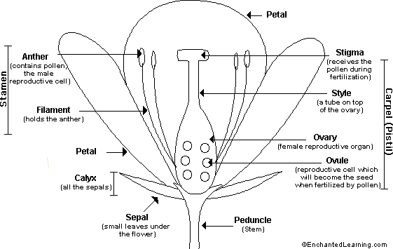

Slide 9
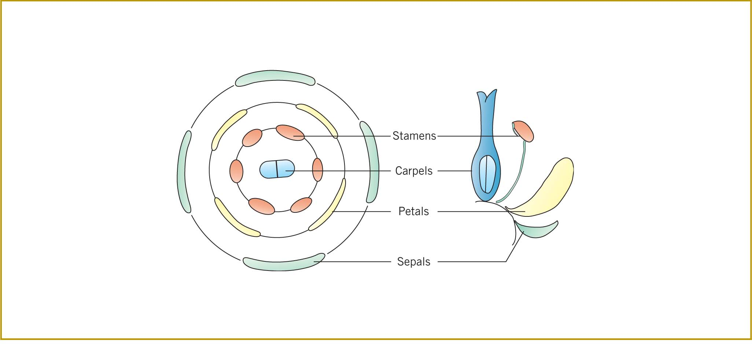

Slide 10
The last two whorls are called essential whorls of the flower. In most flowers stamens and pistil are found in the same flower, such flowers are called hermaphrodite or bisexual flowers .
In other flowers only one of the essential whorls is found such flowers are called unisexual flowers such as Cucurbits, Mulberry etc. Flowers which have only stamens are called staminate flowers and those in which only pistill are present as pistillate flowers.

Slide 11
Developmental Stages of Flowering
Flowering is an attractive system for the study of development in plants. During the flowering process a series of unique events occur that represent all of the aspects of plant development: organogenesis, cell division, cellular differentiation and alterations in gene expression.
Over the years, flowering in a number of species, including maize (Zea mays), petunia (Petunia sps.), snapdragon (Antirrhinum sps.), tobacco (Nicotiana tobacum), and annual ryegrass (Lolium temulentum), has been the subject of molecular and genetic studies. More recently, focus has shifted to the model plant Arabidopsis, where a number of genes that influence flowering have been identified and a model proposed to account for the genetic specification of floral organ initiation.

Slide 12
Flower Evocation
During vegetative development, the fates of the meristematic cells become altered in ways that cause them to produce new types of structure called flower. This phenomenon is known as phase change.
The series of events occurring in the shoot apex that specifically perform the apical meristem to produce flowers are collectively referred to as flower evocation. There are several internal and external factors that involved evocation.
The developmental signals that bring about floral evocation include endogenous factors, such as circadian rhythms, phase change, and hormones, and external factors, such as day length (photoperiod) and temperature (vernalization).

Slide 13
In the case of photoperiodism, transmissible signals from the leaves, collectively referred to as the floral stimulus, are translocated to the shoot apical meristem. The interactions of these endogenous and external factors enable plants to synchronize their reproductive development with the environment.
The transition from vegetative to reproductive development is a very critical phase in the life cycle of higher plants. When the higher plant change from vegetative to reproductive growth, a new set of structures, the flower, is formed and represents the expression of genes not previously expressed.
The transition to flowering involves major changes in the pattern of morphogenesis and cell differentiation at the shoot apical meristem.
While flowering (flower development) is a single continuous process, for clarification of discussions it is commonly divided into three phases, flower initiation, flower formation and differentiation of the flower structure.
As presently, the stages of flowering are (1) floral initiation involving differentiation of the floral primordium; (2) floral organization or differentiation of individual floral parts; (3) floral maturation, leading to the growth of floral parts and differentiation of the sporogenous tissues; and (4) anthesis, or opening of the flower.

Slide 14
Flower initiation
Flowering in many plants is influenced by environmental factors such as photoperiod and temperature and involves the synthesis of a mobile floral stimulus in the leaves.
Other plants do not require external inputs and the signal is generated in the leaves when the plant simply reaches a minimum stage of development.
In any case, flower development is initiated when that signal arrives at the shoot apical meristem. During the vegetative state, the shoot apical meristem is programmed to produce leaf primordia.
When the floral signal arrives, the meristem obtain floral identity and secondary inflorescence meristems, or floral primordia, arise in the axils of the uppermost leaf primordia.

Slide 15
SAM is a collection of cells that has the capacity to continuously renew itself by cell division, and to generate new above-ground tissues and organs in leaves, stems, flowers, and fruits. Based on the developmental fates, cells in the SAM are divided into three layers: the epidermal cell layer (L1) that forms the epidermis of all above-ground organs such as shoots, leaves, and flowers; the subepidermal cell layer (L2) that produces mesophyll cells; the underlying cell layer (L3) that develops into the vascular and internal tissues.
Based on relative locations, cells in the SAM are also divided into three zones, the peripheral zone (PZ), the central zone (CZ), and the rib zone (RZ).
Peripheral zone cells give rise to cells which contribute to the organs of the plant, including leaves, inflorescence meristems, and floral meristems.
The central zone is a small group of slowly dividing cells can be found. Cells of this zone have a stem cell function and are essential for meristem maintenance.
The rib zone (RZ) is located below the CZ and provides cells for the stem.
Multipotent stem cells are located in L1, L2, and part of the L3 layer of the CZ, with a relatively low rate of cell divisions, and function as the source cells for the PZ and RZ.

Slide 16
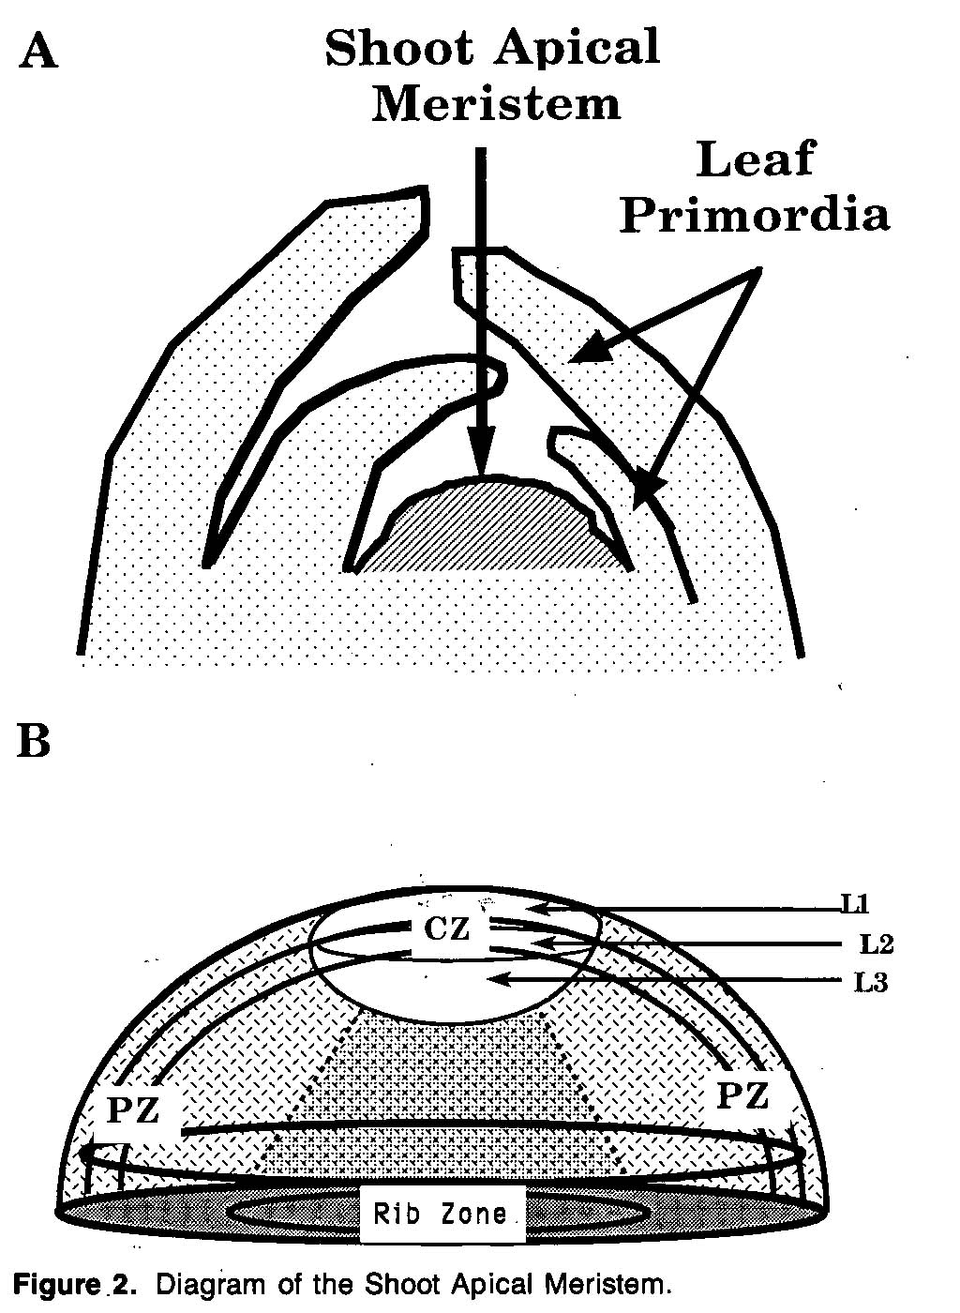

Slide 17
Flower initiation is an internal physiological change in the meristem, which proceeds any morphological change. The first morphological change indicating enhanced cell division in the central zone immediately below the apical part of vegetative meristem. The divisions occurring here result in the differentiation of parenchyma cells which surround the meristem giving rise to flower primordia.
Floral meristems usually can be distinguished from vegetative meristems, even in the early stages of reproductive development, by their larger size. The transition from vegetative to reproductive development is marked by an increase in the frequency of cell divisions within the central zone of the shoot apical meristem. In the vegetative meristem, the cells of the central zone complete their division cycles slowly. As reproductive development begins, the increase in the size of the meristem is largely a result of the increased division rate of these central cells.
Recently, genetic and molecular studies have identified a network of genes that control floral morphogenesis in Arabidopsis, snapdragon (Antirrhinum), and other species.

Slide 18
The use of genetic mutants that alter flowering-time and the initiation of floral primordia has been a powerful tool for identifying many of the genes involved and dissecting the various pathways that lead to flowering.
As a general rule, mutants that cause early flowering indicate a wild type gene that normally suppress flowering while mutants that cause late flowering point to a wild type gene that normally promotes flowering.

Slide 19
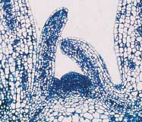
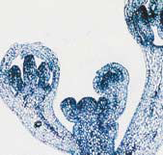
vegetative
reproductive

Slide 20
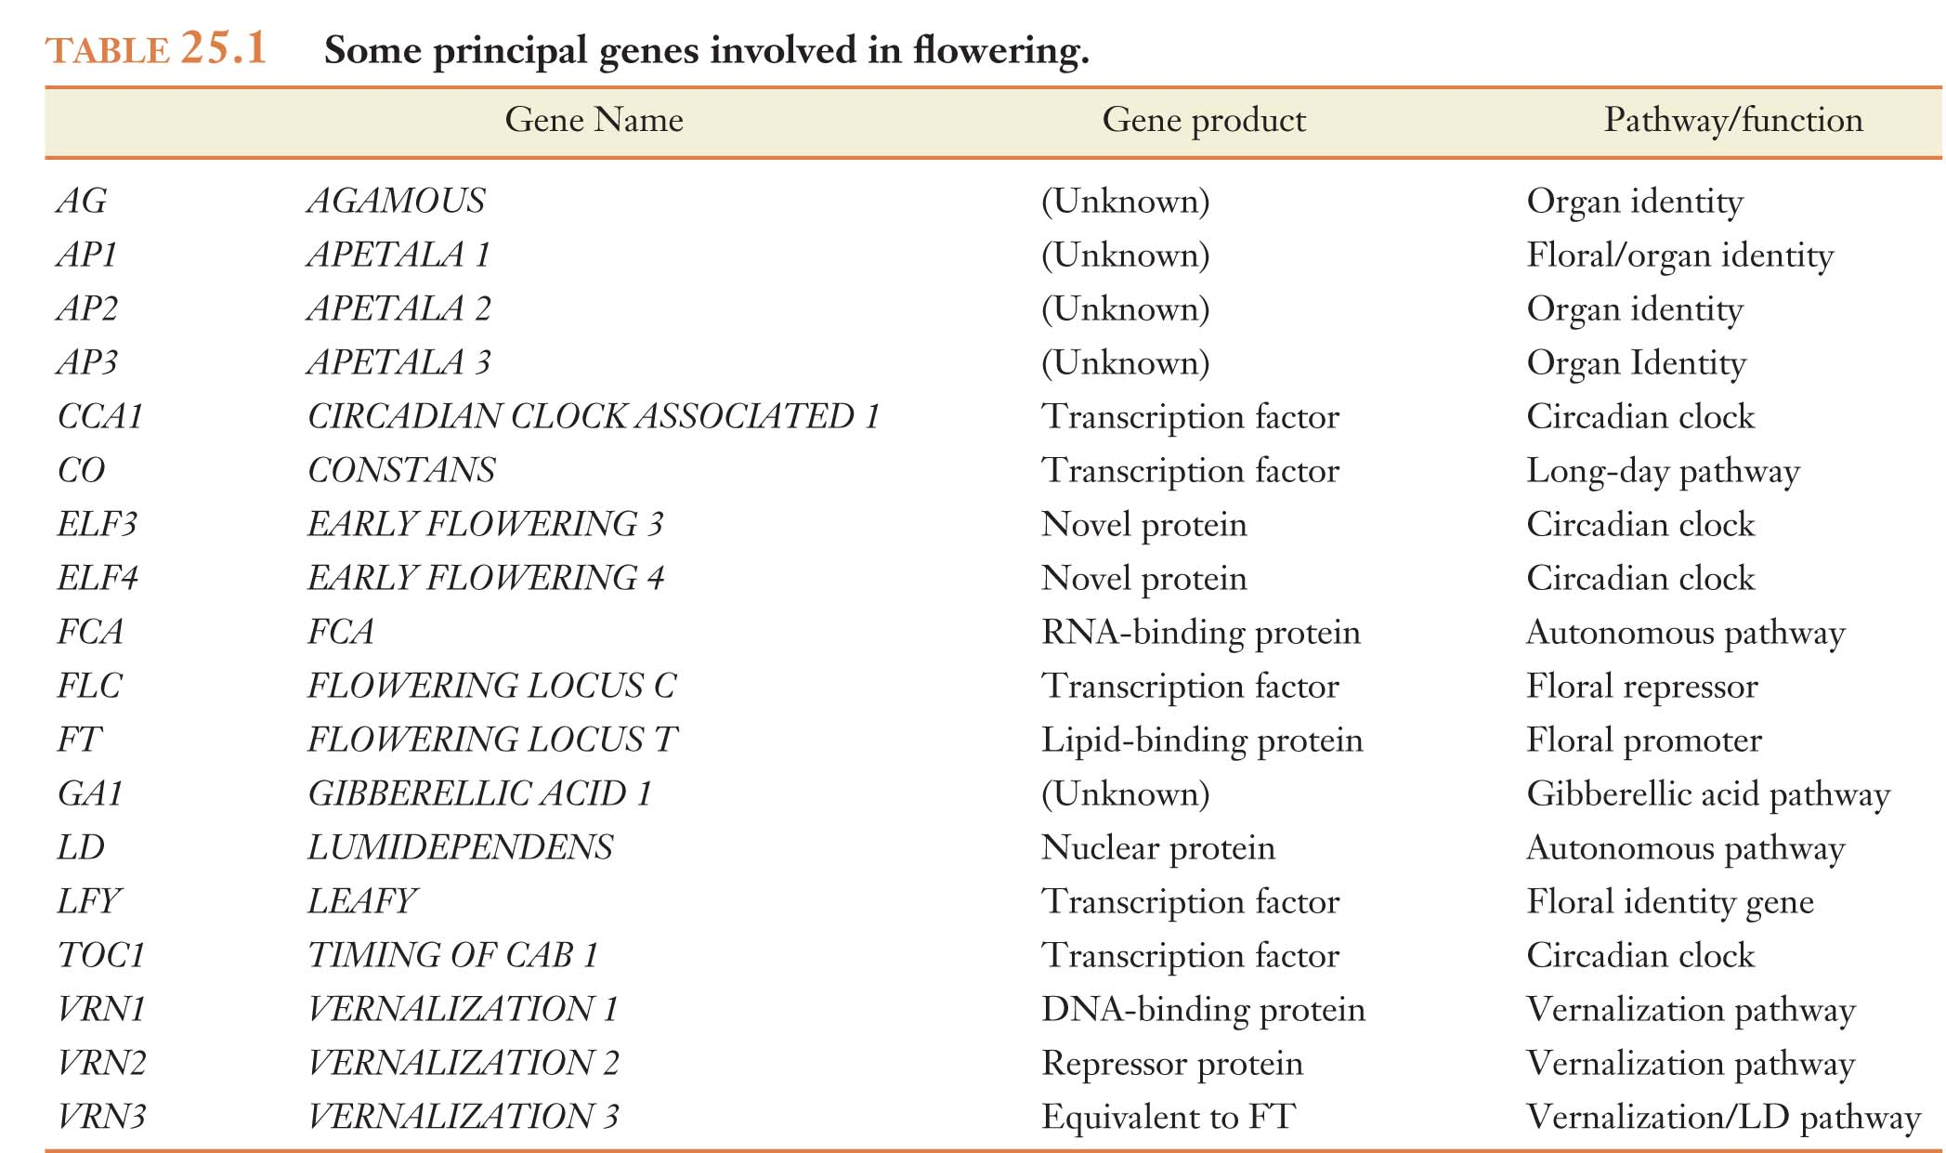

Slide 21
Four Types of Genes Regulate Flower
Development
Four classes of genes that regulate flower development have been identified:
Flowering-time genes
Floral identity genes
Organ identity genes
Cadastral genes

Slide 22
Flowering -time genes
The first set of genes comprises the flowering-time genes. Flowering-time genes determine when the plant initiates flowering, either in response to the appropriate environmental signal or by monitoring the developmental state of the plant.
Flowering time genes must be active for the primordia formed at the sides of the apical meristem to become floral meristems.
These genes are the positive regulators of floral identity gene.
Flowering-time genes provide the connection between florigen, or the floral induction signal, and the transition to the production of floral organs.

Slide 23
Most mutations of the flowering-time genes cause the plants to flower later than normal, although a few will cause flowering to advance.
One role of flowering-time genes is to activate the expression of floral-identity genes.
SHORT VEGETATIVE PHASE (SVP) GENE

Slide 24
Floral identity genes
Directly control floral identity. The plant-specific transcription factor LEAFY (LFY) has central, evolutionarily conserved roles in this process
Floral identity genes are expressed in the apical meristem prior to the formation of floral organs but their expression is regulated rapidly following floral induction by internal (autonomous) or external factors.
Floral-identity genes commit undifferentiated primordia to the production of floral rather than vegetative structures.
The proteins encoded by these genes are transcription factors that likely control the expression of other genes whose products are involved in the formation and/or function of floral organs.

Slide 25
Organ identity genes
The floral-identity genes activate a set of organ-identity genes that serve to control the subsequent development of floral organs such as sepals, petals, stamens, and carpels.
Five different genes are known to specify floral organ identity in Arabidopsis: APETALA1 (AP1), APETALA2 (AP2), APETALA3 (AP3), PISTILLATA (PI), and AGAMOUS (AG).
Mutations in the organ-identity genes generally result in the modification, displacement, or total absence of floral organs. In addition, mutations in any one of these genes generally influence the development of two adjacent floral organs.

Slide 26
The Four Different Types of Floral Organs Are
Initiated as Separate Whorls
Floral meristems initiate four different types of floral organs: sepals, petals, stamens, and carpel (Pistil). These sets of organs are initiated in concentric rings, called whorls, around the side regions (flank) of the meristem.
Each whorl are determined by overlapping developmental fields. These fields correspond to the expression patterns of specific organ identity genes.
The Arabidopsis flower is rather typical among advanced flowering plants, consisting of four distinct whorls of floral organs.

Slide 27
The influence of organ-identity genes on the development of the Arabidopsis flower can best be understood by viewing the floral meristem as three overlapping developmental fields or fields of gene activity; designated A, B, and C.
Field A includes the sepals and petals (whorls 1 and 2), field B includes the petals and stamens (whorls 2 and 3), and field C includes the stamens and central carpels (whorls 3 and 4).

Slide 28
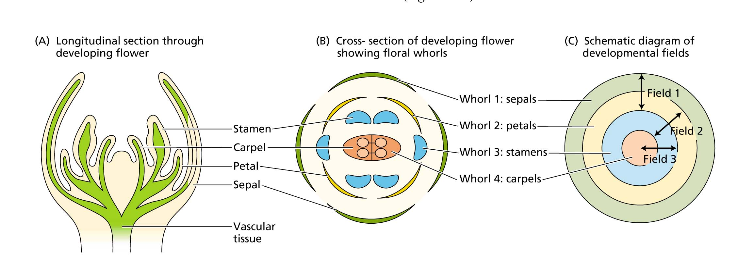
Arabidopsis: A model plant

Slide 29
This view is referred to as the:
ABC model for floral organ specification
In which a particular gene or pair of genes is associated with each developmental field, but controls the identity of two adjacent whorls of organs

Slide 30
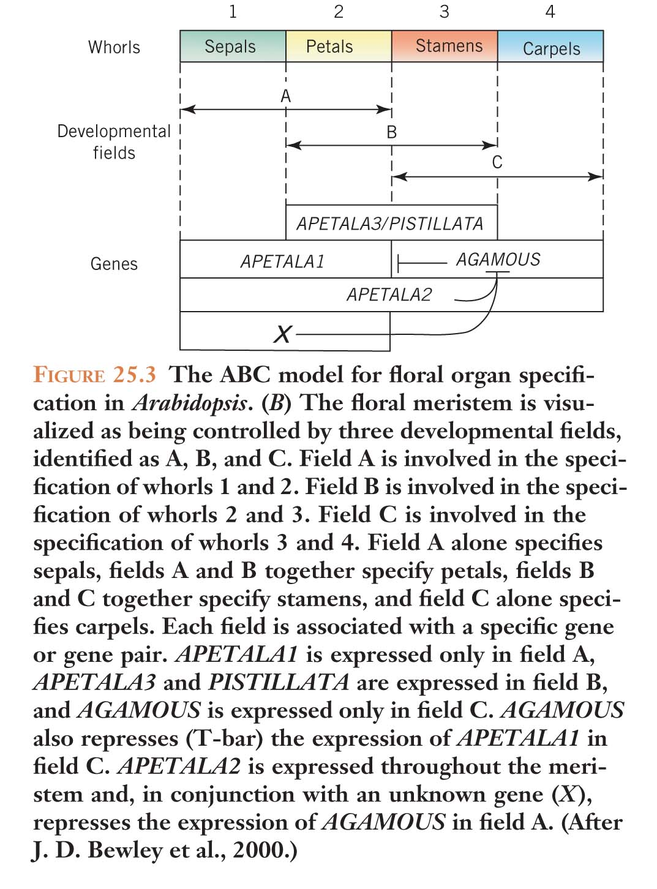

Slide 31
Cadastral genes
That restrict the action of other genes to specific regions of the organism.
Act as spatial regulators of the floral organ identity genes by setting boundaries for their expression.
The word cadastre refers to a map or survey showing property boundaries for taxation purposes.

Slide 32
FLORAL EVOCATION: INTERNAL AND
EXTERNAL CUES (signals)

Slide 33
A plant may flower within a few weeks after germinating, as in annual plants such as groundsel (Senecio vulgaris).
Alternatively, some perennial plants, such as many forest trees, may grow for 20 or more years before they begin to produce flowers.
Different species flower at widely different ages, indicating that the age, or perhaps the size, of the plant is an internal factor controlling the switch to reproductive development.
The case in which flowering occurs strictly in response to internal developmental factors and does not depend on any particular environmental conditions is referred to as autonomous regulation.

Slide 34
In contrast to plants that flower entirely through an autonomous pathway, some plants exhibit an absolute requirement for the proper environmental cues in order to flower. This condition is termed an obligate or qualitative response to an environmental cue.
In other plant species, flowering is promoted by certain environmental cues but will eventually occur in the absence of such cues. This is called a facultative or quantitative response to an environmental cue. The flowering of this group of plants, which includes Arabidopsis, thus relies on both environmental and autonomous flowering systems.
Photoperiodism and vernalization are two of the most important mechanisms underlying seasonal responses.
Photoperiodism is a response to the length of day; vernalization is the promotion of flowering, at subsequent higher temperatures, brought about by exposure to cold

Slide 35
Other signals, such as total light radiation and water availability, can also be important external cues.
The evolution of both internal (autonomous) and external (environment-sensing) control systems enables plants to carefully regulate flowering at the optimal time for reproductive success.
For example, in many populations of a particular species, flowering is synchronized. This synchrony favors crossbreeding and allows seeds to be produced in favorable environments, particularly with respect to water and temperature.

Slide 36
The Shoot Apex & Phase Changes
All multicellular organisms pass through a series of more or less defined developmental stages, each with its characteristic features. In humans, infancy, childhood, adolescence, and adulthood represent four general stages of development, and sexual maturity is the dividing line between the non reproductive and the reproductive phases. Higher plants likewise pass through developmental stages, but whereas in animals these changes take place throughout the entire organism, in higher plants they occur in a single, dynamic region, the shoot apical meristem (SAM).

Slide 37
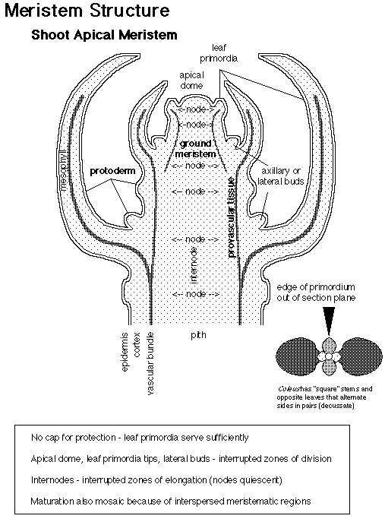
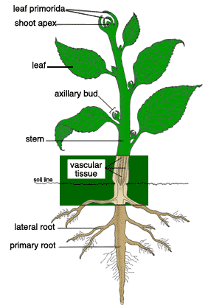
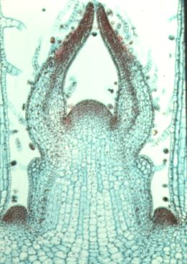

Slide 38
Shoot Apical Meristems (SAM) Have Three
Developmental Phases
Vegetative growth eventually leads to a transition to reproductive development. However, plants will not flower, nor respond to environmental stimuli which ensure subsequent flowering, until they have completed a certain period of vegetative growth and reached ‘ripeness to flower’.
During postembryonic development, the shoot apical meristem passes through three more or less well-defined developmental stages in sequence:
The juvenile phase (in which it will not flower)
2. The adult vegetative phase (in which appropriate environmental stimuli will evoke Flowering)
3. The adult reproductive phase (in which flowering actually takes place)

Slide 39
Flowering occurs as a result of a reprogramming of the development of the shoot apical meristem (SAM). Rather than initiating stems, leaves and axillary buds, a reproductive (or floral) meristem gives rise to an inflorescence, i.e. flowers and their subtending bracts.
The sharpness of the transitions between each phase and their duration, vary very widely between species.
A number of environmental factors have been identified which are essential to, or greatly hasten, the transition to reproductive growth.
These have been extensively studied in a selected number of species, however, many species do not require a precise set of environmental stimuli and will flower under almost any conditions compatible with continuing growth.

Slide 40
The primary distinction between the juvenile and the adult vegetative phases is that the latter has the ability to form reproductive structures: flowers in angiosperms.
Unlike the sudden transition from the adult vegetative phase to the reproductive phase, the transition from juvenile to vegetative adult is usually gradual.
However, actual expression of the reproductive ability of the adult phase (i.e., flowering) often depends on specific developmental and environmental signals. Thus the absence of flowering itself is not a reliable indicator of juvenility.
size and age, day length, temperature, nutrients, hormones, and other chemical signals, availability of water,…

Slide 41
The sequence in time of the three developmental phases results in a spatial gradient of three phases along the shoot axis.
Because growth in height is restricted to the apical meristem, the juvenile tissues and organs, which form first, are located at the base of the shoot.

Slide 42
In rapidly flowering herbaceous species, the juvenile phase may last only a few days and few juvenile structures are produced.
In contrast, woody species have a more prolonged juvenile phase, in some cases lasting 30 to 40 years.

Slide 43
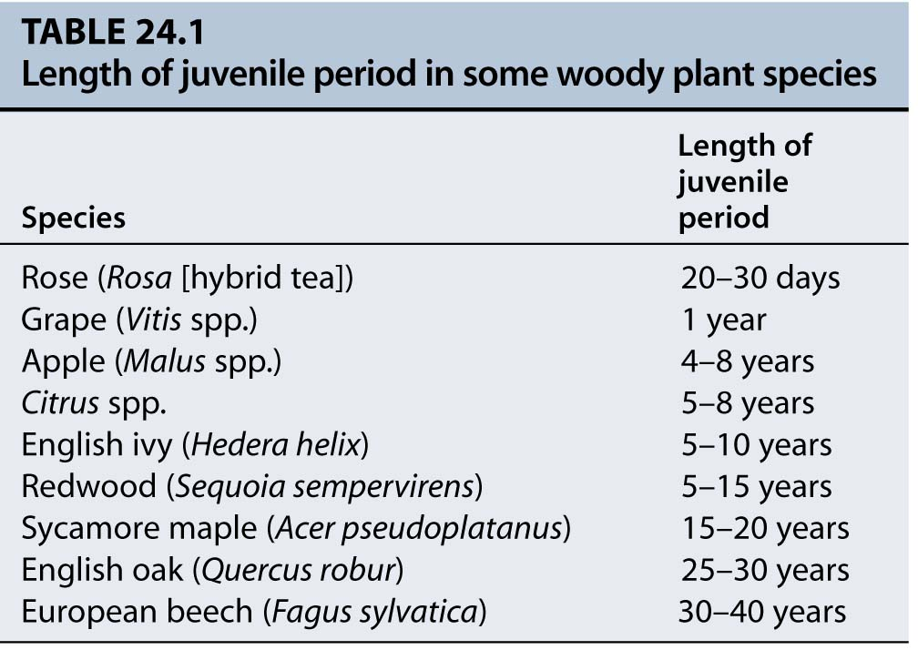

Slide 44
Size and Age

Slide 45
Discussion of signals which control flowering has focused, so far, on plants which respond to temperature and day length. In these plants the number of vegetative nodes which will develop from the shoot apical meristem (SAM) before it switches to reproductive development is strongly influenced by environmental signals. The great variation in the ages at which different species first flower can be attributed to differences in the length of the juvenile period.
However, many plants which grow at lower latitudes, where the seasonal variation in day length and temperature is much less marked, flower only once they have attained a certain size.
In many varieties of tobacco the SAM becomes committed to flowering only once they have attained certain number of phytomers (internodes with their leaves)

Slide 46
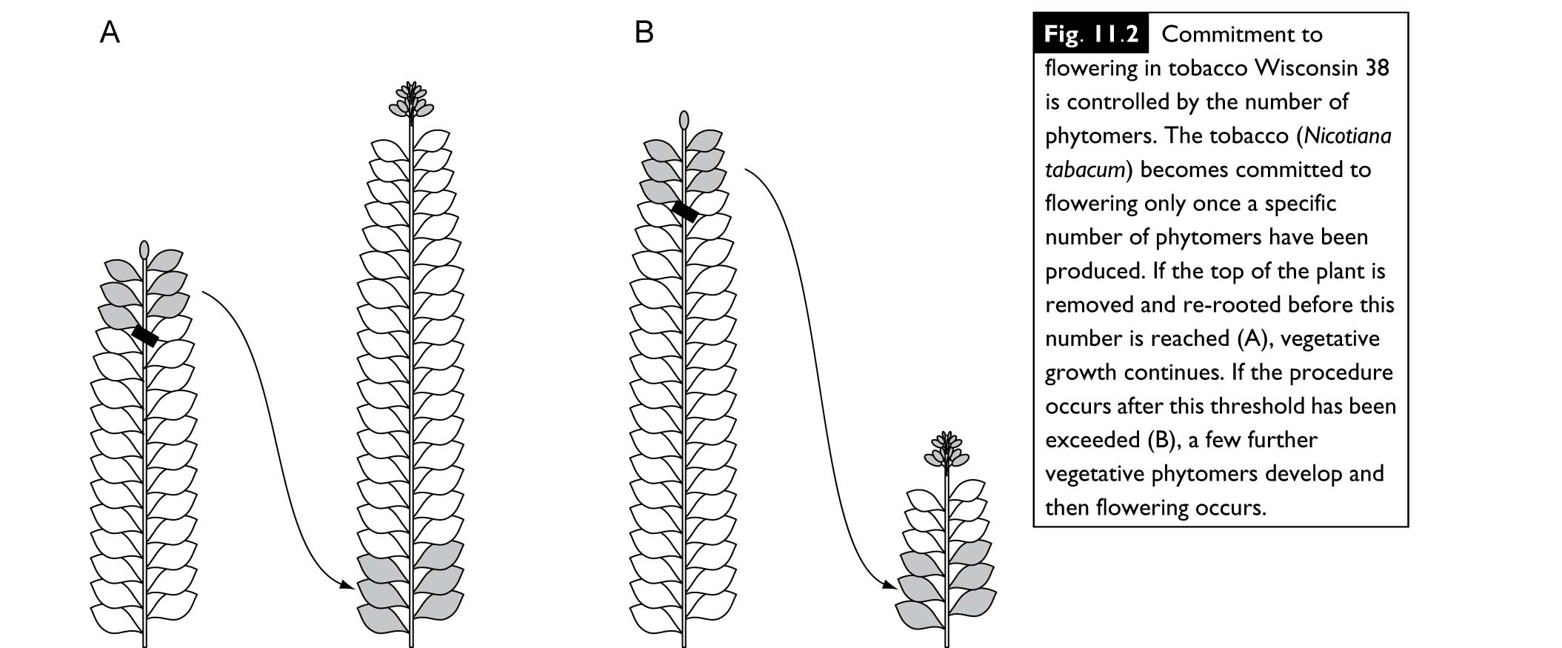

Slide 47
Attainment of a sufficiently large size appears to be more important than the plant’s chronological age in determining the transition to the adult phase.
Although plant size seems to be the most important factor, it is not always clear which specific component associated with size is critical. In some Nicotiana species, it appears that plants must produce a certain number of leaves to transmit a sufficient amount of the floral stimulus to the apex.
In some species, the juvenile meristem appears to be capable of flowering but does not receive sufficient floral stimulus until the plant becomes large enough. In mango (Mangifera indica), for example, juvenile seedlings can be induced to flower when grafted to a mature tree. In many other woody species, however, grafting to an adult flowering plant does not induce flowering.

Slide 48
Photoperiodism

Slide 49
The experimental study of the role of light in controlling flowering dates from the work of W.W. Garner and H.A. Allard, first published in 1920.
These workers noticed that the tobacco (Nicotiana tobacum) failed to flower and set seed during the summer despite its vigorous vegetative growth. However, cuting which were transferred to the glasshouse readily gave rise to small flowering plants during the winter months.
Garner and Allard therefore examined the effect of day length by extending the natural day with artificial light or shortening the day by placing plants in light-proof cabinets for the required time.
The outcome of these studies was a demonstration that these varieties of tobacco required a period of exposure to short days in order to flower and that, after an appropriate period of short days, they would flower irrespective of the subsequent day length.
This discovery has led to the concept of photoperiodic induction of flowering.

Slide 50
Photoperiodic responses fall into one of three general categories. They are: short-day plants (SD plants), long-day plants (LD plants), and day length-indifferent or day-neutral plants (DNP)
Short-day plants are those that flower only, or flower earlier, in response to day lengths that are shorter than a critical value within a 24-hour cycle. Long-day plants respond to day lengths that are longer than a critical value, while day-neutral plants flower irrespective of day length.
Long-day plants can effectively measure the lengthening days of spring or early summer and delay flowering until the critical day length is reached.
SDPs often flower in fall, when the days shorten below the critical day length, as in many varieties of Chrysanthemum morifolium.

Slide 51
Within the long- and short-day categories, we also recognize obligate and facultative requirements. Plants that have an absolute requirement for a particular photoperiod before they will flower are considered obligate photoperiodic types.
The common cocklebur (Xanthium strumarium), for example, is an obligate short-day plant. Xanthium will not flower unless it receives an appropriate short photoperiod.
On the other hand, most spring cereals such as spring wheat (Triticum sp.) and rye (Secale cereale) are facultative long-day plants. Although spring cereals will eventually flower even if maintained under continuous short days, flowering is dramatically accelerated under long days.

Slide 52
In addition to these three basic categories, there are a number of other response types that flower under some combination of long and short days. Various species of the genus Bryophyllum are, for example, long-short-day plants (LSD plant) they will flower only if a certain number of short days are preceded by a certain number of long days.
The reverse is true of the short-long-day plant (SLD plant) Trifolium repens (white clover) and Echeveria harmsii (echeveria),.
A few plants have highly specialized requirements. Intermediate day length plants, for example, flower only in response to day lengths of intermediate (12 to 14 hours) length but remain vegetative when the day is either too long or too short.
Another type of behavior is amphi photoperiodism, illustrated by Madia elegans (tarweed). In this case, flowering is delayed under intermediate day length (12 to 14 hours) but occurs rapidly under day lengths of 8 hours or 18 hours.

Slide 53
Many plants require more or less continuous exposure to the appropriate photoperiod, at least until floral primordia have been developed, in order to flower successfully.
Such plants are said to be induced and the appropriate photoperiod is referred to as an inductive treatment.

Slide 54
Night length, rather than day length, regulates
Flowering
If plants are grown under artificial conditions it is possible to alter the lengths of the light and dark periods independently. Such an approach demonstrated that it is actually the length of the night which is important in inducing flowering in X. strumarium.
Therefore a short-day plant could more appropriately be referred to as a long night plant, although the reference to day length has become fixed in the literature. Conversely, long-day plants are really short-night plants. The long-day plant Hyoscyamus niger will flower only when the dark period does not exceed 13 h, i.e. when the dark period is shorter than a critical value.

Slide 55
Daylength is sensed in the leaves
Photoperiodic induction occurs in the leaves, and the flowering stimulus moves in the phloem from the leaves to the meristems where flowers are to be initiated.
If Xanthium plants are defoliated so that only a single leaf remains, exposure to appropriate photo inductive conditions will still lead to flowering. Likewise, if just one leaf is induced, whilst the others are held under non-inductive conditions flowering results.
The flowering stimulus can be transmitted from an induced to a non-induced plant of the same species by grafting and, in some cases, transmission is possible between species, even if these have different photoperiodic requirements.
The induction of flowering may be stimulated in a SDP (non-induced) by transmission from a LDP (induced).

Slide 56
Such experiments have led to the hypothesis that induced leaves produce a supposed flowering hormone, florigen, which induces flowering. This concept has now lasted over 60 years but the compound itself has steadily resisted to identification.

Slide 57
Phytochrome Is the Primary Photoreceptor in Photoperiodism
Plants measure night length using a chemical called phytochrome. Phytochrome has two chemical forms; phytochrome far-red (Pfr) and phytochrome red (Pr).
Phytochrome is located in the leaves; so it is the leaves which are responsible for measuring the photoperiod.
Phytochrome is called a photoreceptor because it is a chemical which absorb light energy. Pr absorb red light energy (666nm) and is chemically converted into Pfr. Pfr absorbs far-red light (730 nm) and is converted into Pr.

Slide 58
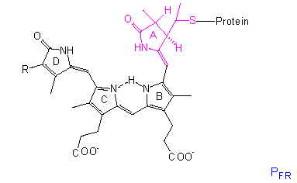
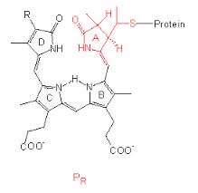

Slide 59
Phytochrome Fr is the biologically active form of phytochrome but is it florigen? Most research indicates that phytochrome cannot move from the leaf cells to the meristem tissue.
In 2005 a substance, mRNA (FT mRNA) (FLOWERING LOCUS T) was finally isolated that was found to be moving from leaf to flower meristem.
This mRNA provides a link between the phytochrome system (the receptor), its activation of genes in the leaf (mRNA synthesis) and the differentiation of the meristem into the flower structure.

Slide 60
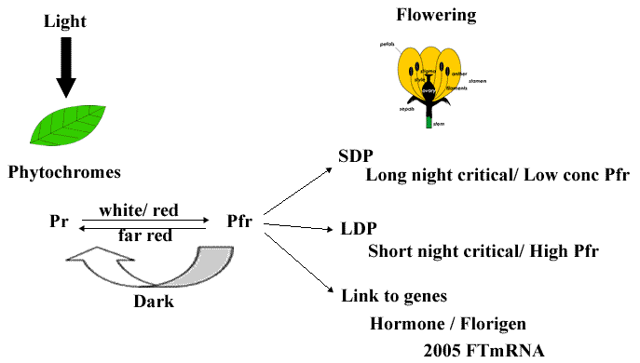

Slide 61
Night-break experiments are well suited for studying the nature of the photoreceptors involved in the reception of light signals during the photoperiodic response. A night break is a short exposure of light in the middle of the night, which has been shown “cancel out” the effectiveness of the dark period. The inhibition of flowering in SDPs by night breaks was one of the first physiological processes shown to be under the control of phytochrome. However a short burst of darkness in the middle of the day appears to have no effect.
Red light inhibit flowering of SDPs when given in the middle of a long dark period, but far-red light has no effect. However if a few minutes of far red light are given immediately after the red light, the plants flower. The red/far red treatments can be repeated several times, flowering/no flowering depending upon the last treatment (red vs far red)
Many SDPs will still flower when the days are artificially long, provided that the night is of adequate length also. This demonstrated that in SDPs; it is actually the duration of the dark period that determines whether floral initiation commences. The other evidence comes from experiments using night breaks.

Slide 62
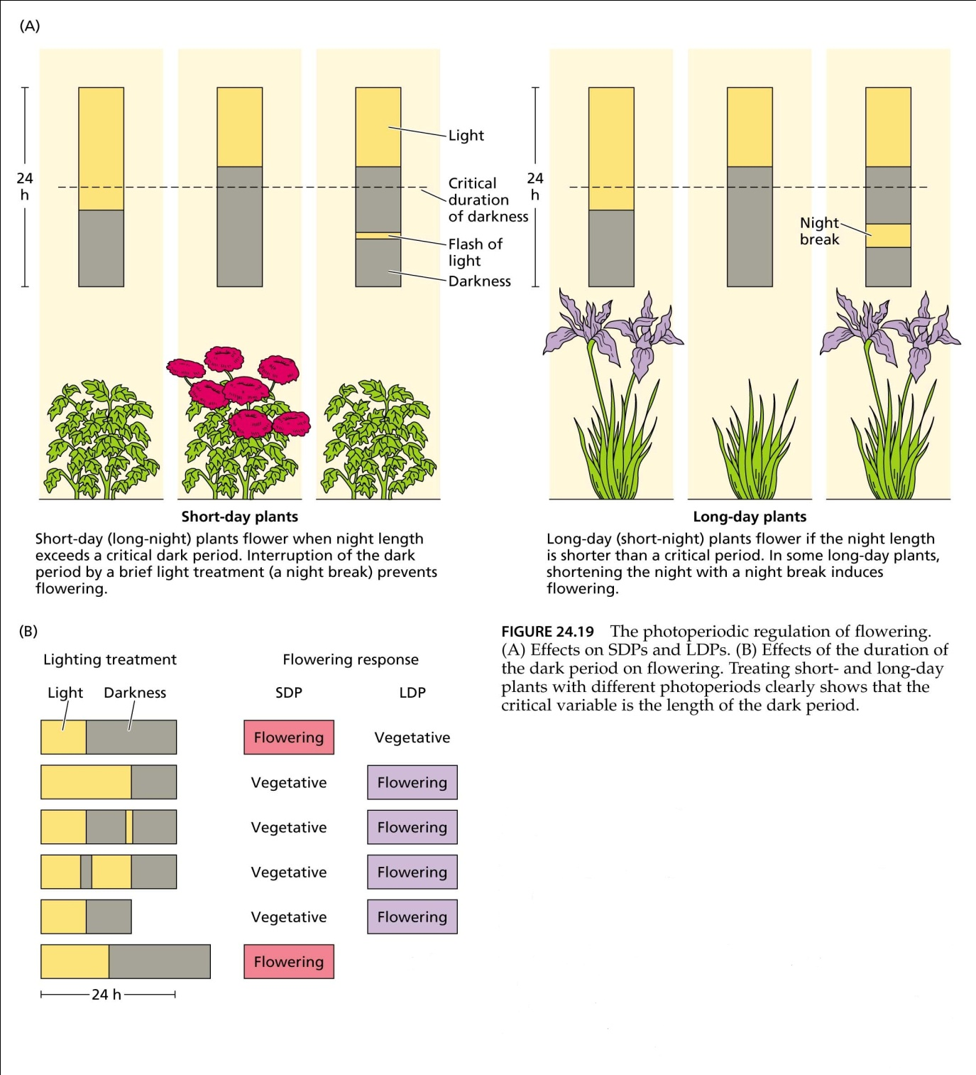

Slide 63
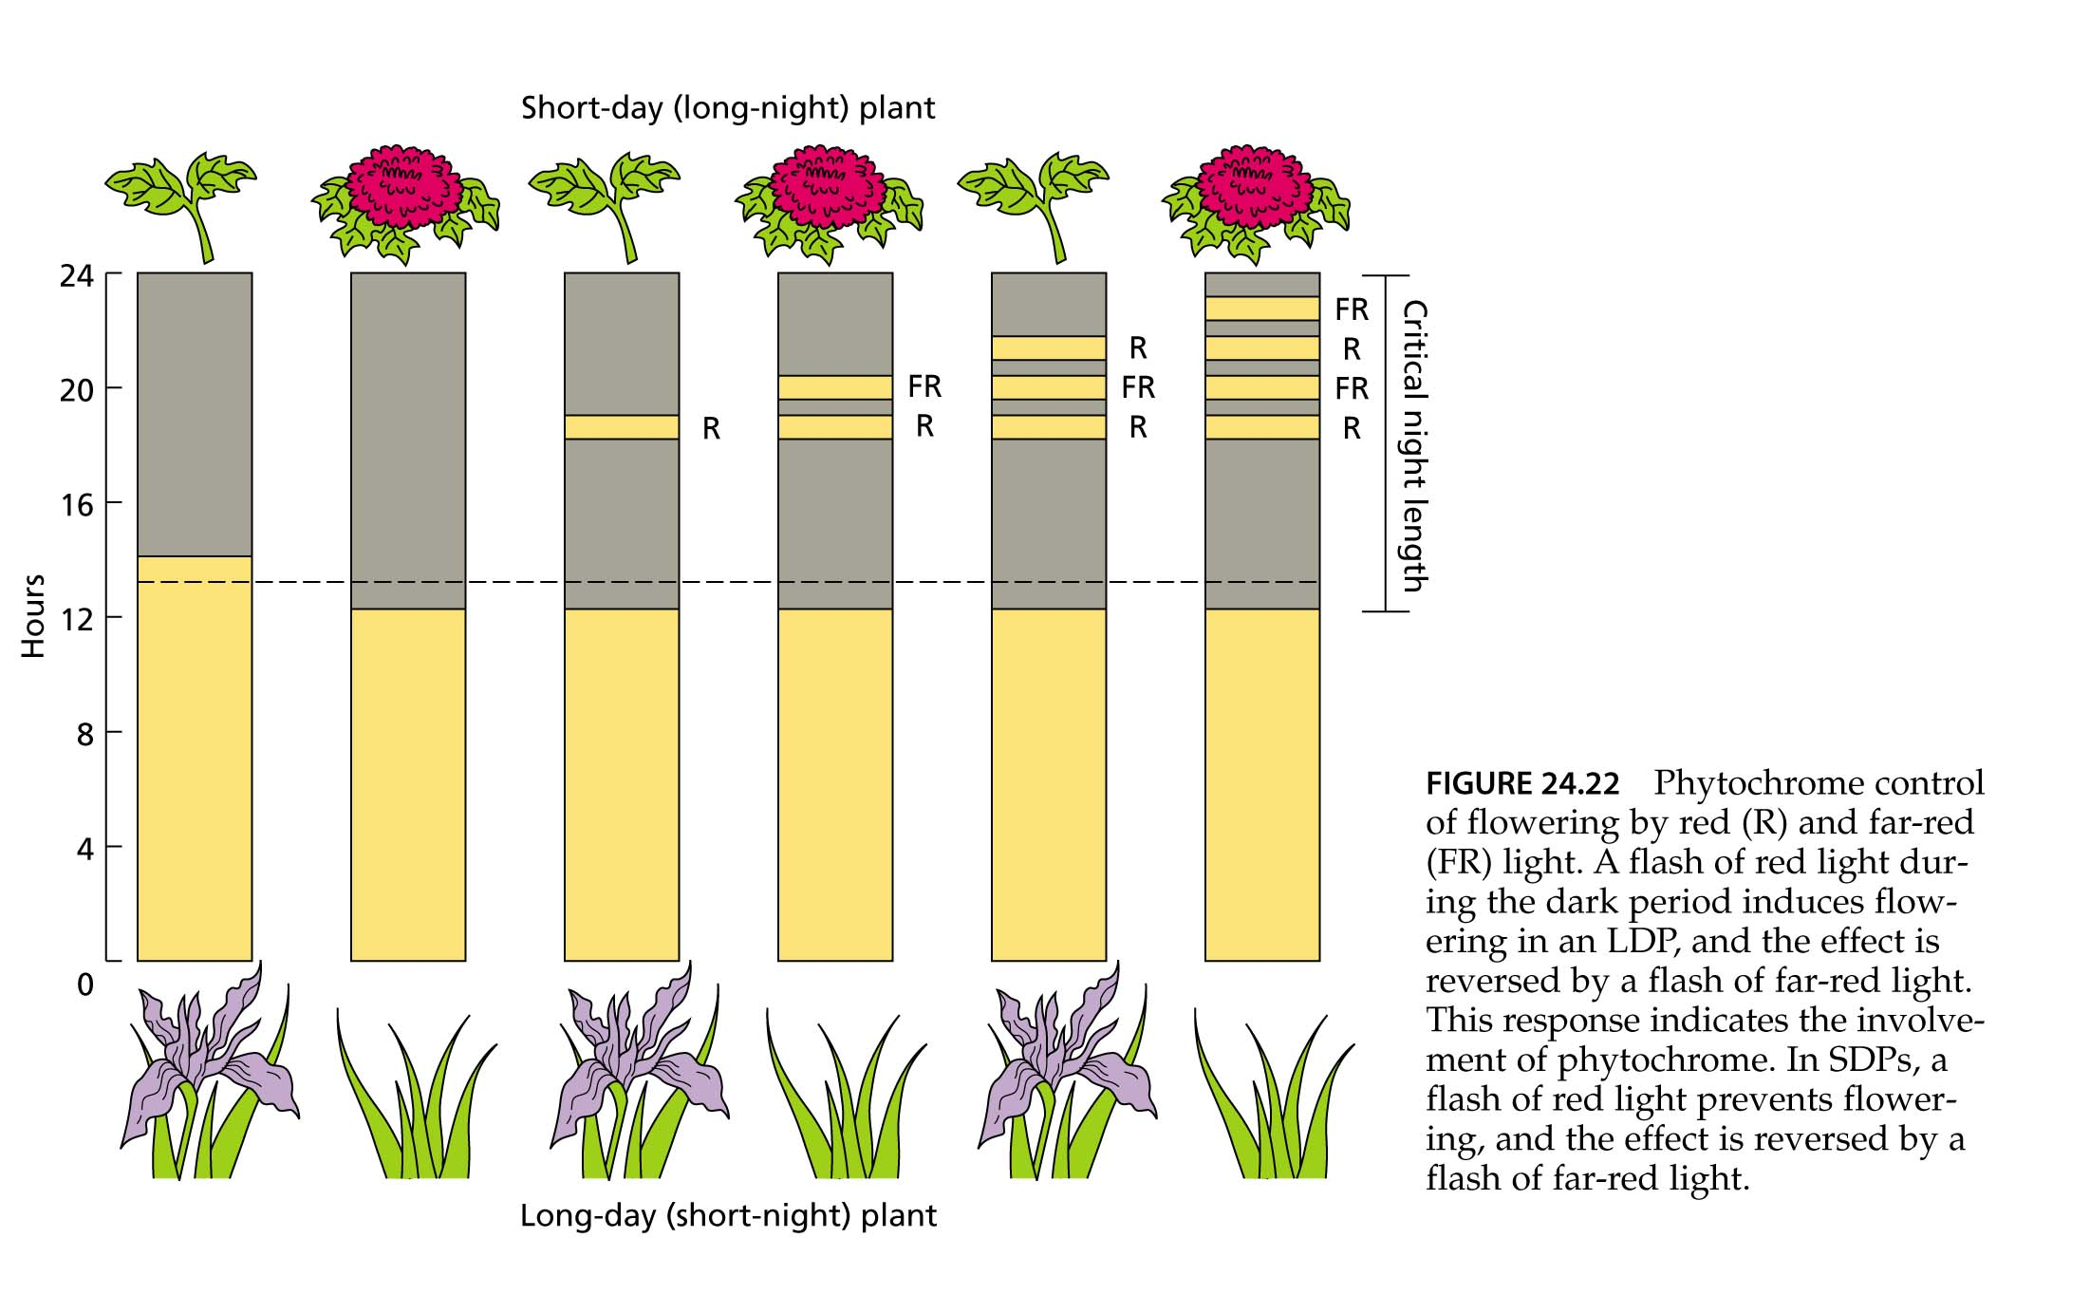

Slide 64
Since the sun produces both red and far-red light, there is constant inter conversion between Pr and Pfr and an equilibrium develops. Conversion of one form to another can occur within milliseconds. Pfr is biologically active, while Pr is inactive.
During the night Pfr very slowly degrades to Pr in a process called dark reversion so that in the morning there is a lot more Pr than Pfr..
When there is a short day (long night), a lot of Pfr will be degraded to Pr.
When there is a long day (short night), little Pfr will be degraded to Pr.

Slide 65
VERNALIZATION:
PROMOTING FLOWERING WITH COLD
Vernalization is the process whereby flowering is promoted by a cold treatment given to a fully hydrated seed (i.e., a seed that has imbibed water) or to a growing plant. Dry seeds do not respond to the cold treatment.
Without the cold treatment, plants that require vernalization show delayed flowering or remain vegetative. In many cases these plants grow as rosettes with no elongation of the stem

Slide 66
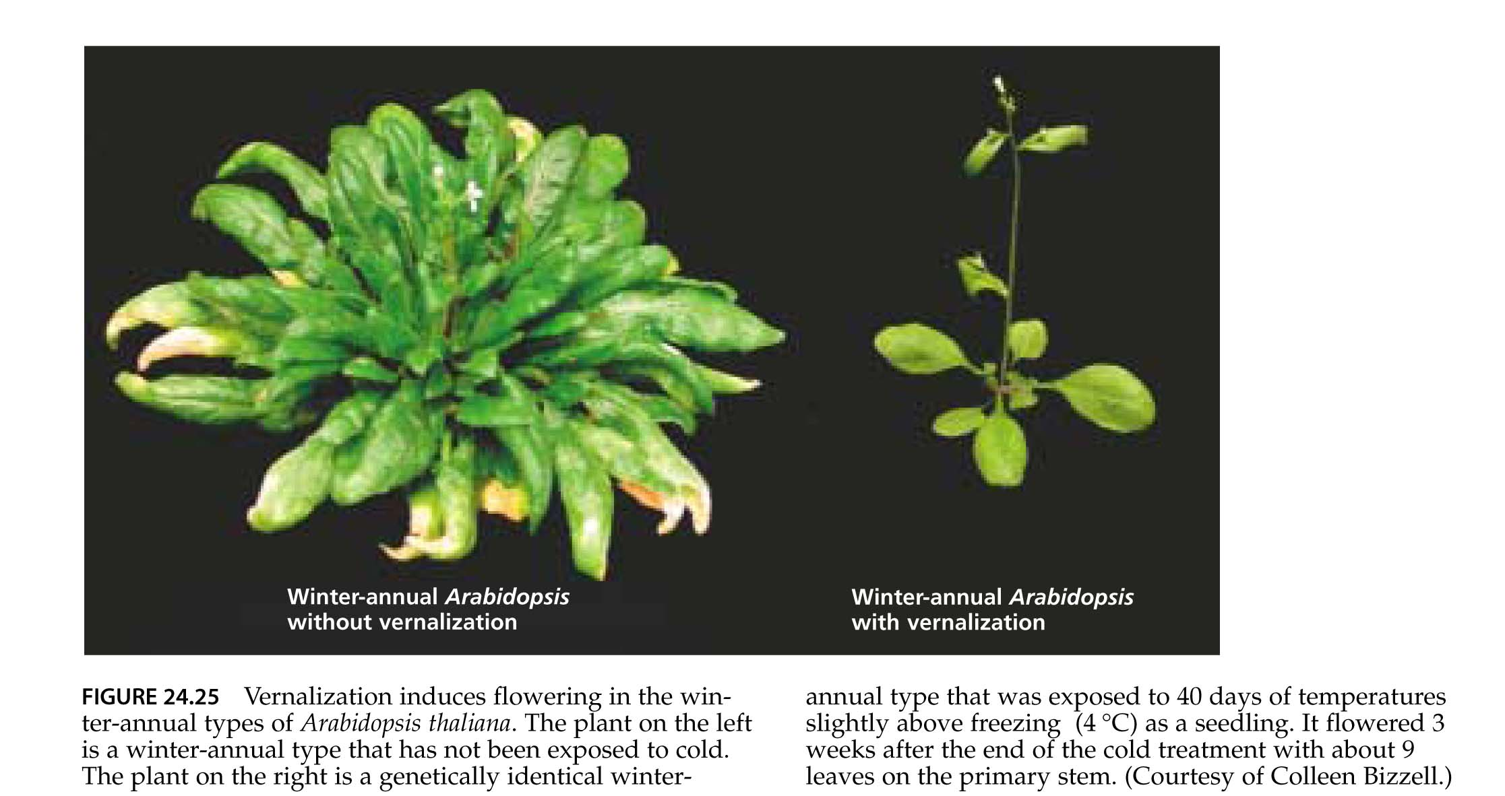

Slide 67
Vernalization Results in Competence to Flower at the Shoot Apical Meristem
Plants differ considerably in the age at which they become sensitive to vernalization. Winter annuals, such as the winter forms of cereals (which are sown in the fall and flower in the following summer), respond to low temperature very early in their life cycle. They can be vernalized before germination if the seeds have imbibed water and become metabolically active.
Other plants, including most biennials (which grow as rosettes during the first season after sowing and flower in the following summer), must reach a minimal size before they become sensitive to low temperature for vernalization.

Slide 68
The effective temperature range for vernalization is from just below freezing to about 10°C, with a broad optimum usually between about 1 and 7°C. The response usually requires several weeks of exposure to low temperature, but the precise duration varies widely with species and variety.
Flowering only occurs after a prolonged exposure to cold temperatures, and many plants that require vernalization require a subsequent photoperiodic response in order to flower.
However, plants exposed to inductive photoperiods will flower after an extended period after the vernalization event.normal vegetative growth continues.

Slide 69
Vernalization appears to take place primarily in the shoot apical meristem. Cooling causes flowering when only the stem apex is chilled, and this effect appears to be largely independent of the temperature experienced by the rest of the plant.
Grafting leaves from plants induced to flower by vernalization to non-induced recipients did not accelerate flowering time, indicating that the site of cold perception is the SAM and not the leaves.

Slide 70
Vernalization May Involve Epigenetic Changes in
Gene Expression
One model for how vernalization affects competence is that there are stable changes in the pattern of gene expression in the meristem after cold treatment.
Changes in gene expression that are stable even after the signal that induced the change (in this case cold) is removed are known as epigenetic regulation.
The involvement of epigenetic regulation in the vernalization process has been confirmed in the LDP Arabidopsis. In winter-annual ecotypes of Arabidopsis that require both vernalization and long days to flower, a gene that acts as a repressor of flowering has been identified: FLOWERING LOCUS C (FLC).
FLC is highly expressed in nonvernalized shoot apical meristems.

Slide 71
After vernalization, this gene is epigenetically switched off by an unknown mechanism for the remainder of the plant’s life cycle, permitting flowering in response to long days to occur. In the next generation, however, the gene is switched on again, restoring the requirement for cold.

